Slide 1
Covid-19 Forecasts: US and Arizona
Exploratory data analysis by Daniel clark and gavin hudgeons

Slide 2
Data source
Sourced from COVID Tracking Project that covers US and Statewide cases
Arizona State-wide Data and U.S. National Data
Date Range: 3/4/2020 – 7/21/2020

Slide 3
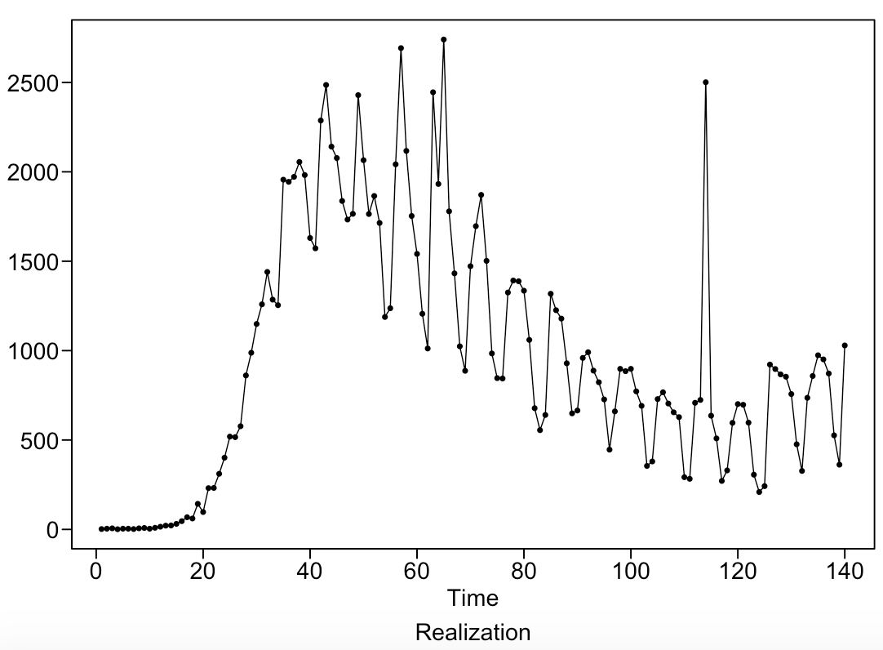
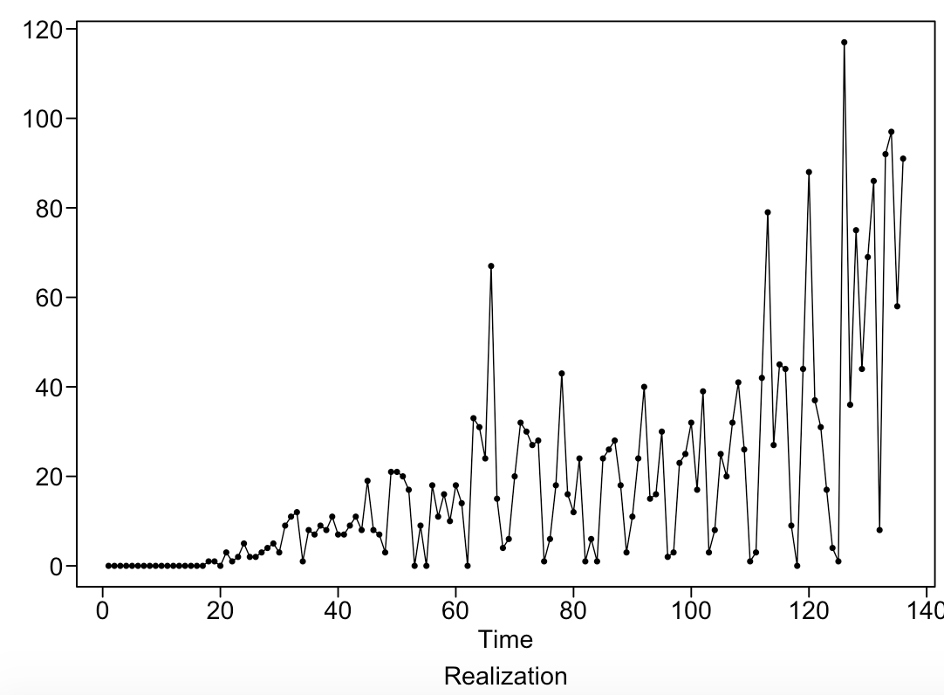
US & AZ Data detail
Key Features: Date, New Deaths per Day, New Hospitalizations Per Day, New Positive Tests Per Day, New Negative Tests Per Day, Total Test Results Per Day, and Positive Percentage*
US Daily dataset: 140 Rows,
US Daily Deaths: Mar. 4 – Jul 21
AZ Daily Deaths: Mar. 4 – Jul. 17
* Positive Percentage reflects the percent of tests that come out positive

Slide 4
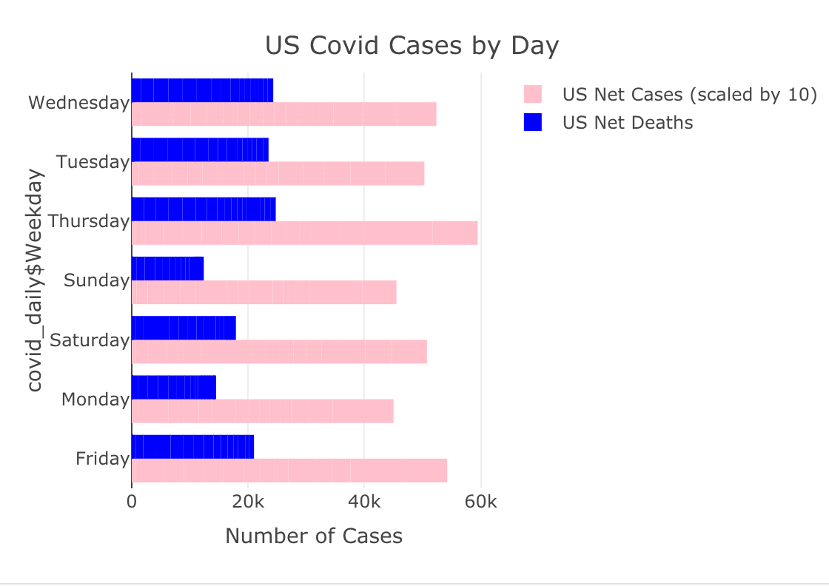
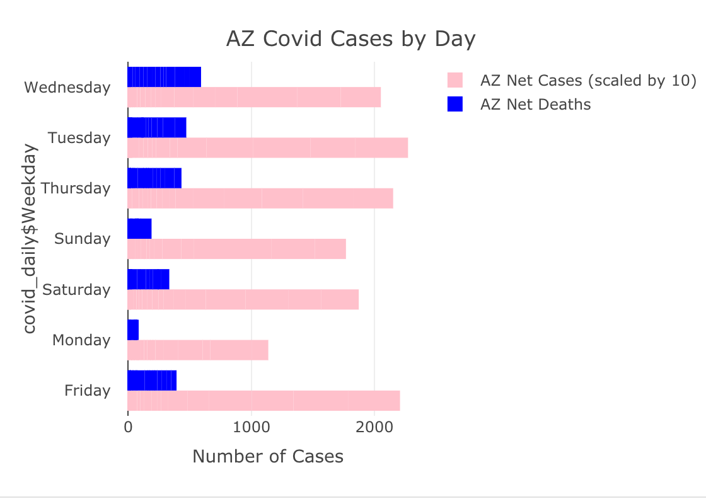
EDA
Similar themes emerge with both the US and AZ data that positive cases and deaths are less reported on Sat-Mon. This may possibly explain any cyclic behavior with our findings.

Slide 5
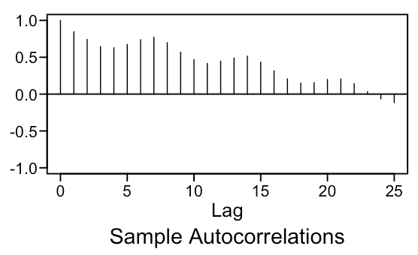
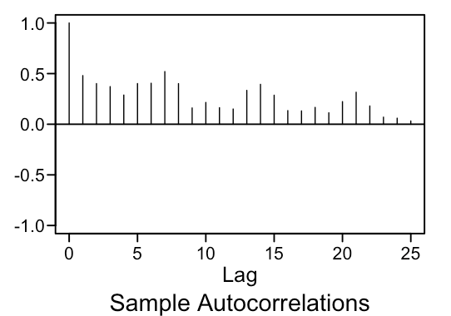
Data Stationarity
US Daily Deaths: Mar. 4 – Jul 21
AZ Daily Deaths: Mar. 4 – Jul. 17
We looked at the stationarity of our key features of interest across the US and Arizona
* Consistent Mean – All of our US and AZ charts show wandering behavior around the mean
* Constant Variance – As time went on, we saw dramatic spikes in our data day over day
* ACFs do not depend on time – We see through our autocorrelations that our ACFs change with time
All of this is evidence against stationarity for all of our key features.

Slide 6
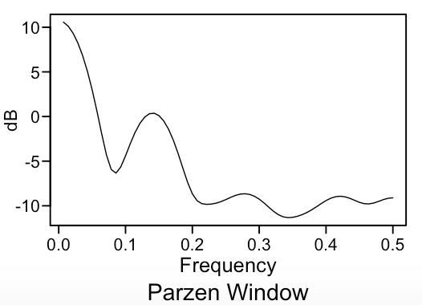
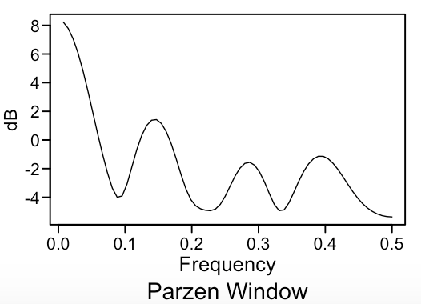
Spectral densities and ACFs
US Daily Deaths - Spectral Density
AZ Daily Deaths - Spectral Density
Reviewing each Spectral Density, we can see a general spike at around .14 which indicates a 7 day cycle, as well as smaller spikes 0.27 and 0.43, which suggest that we may be getting lags for every 9 times and 13 days a month.
The ACFs are dampening with a oscillating behavior which suggests an AR2 model.

Slide 7
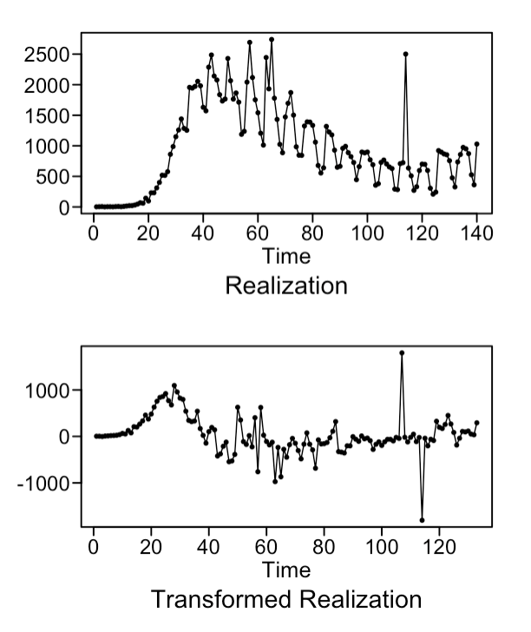
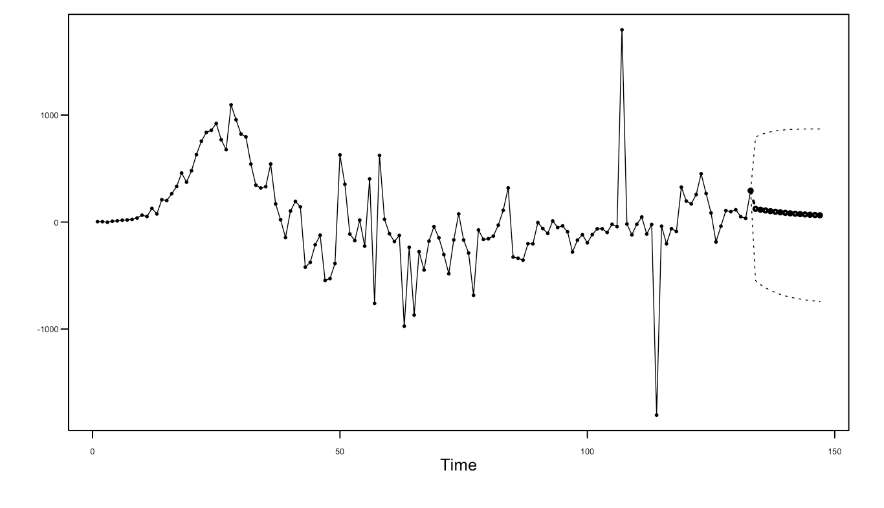
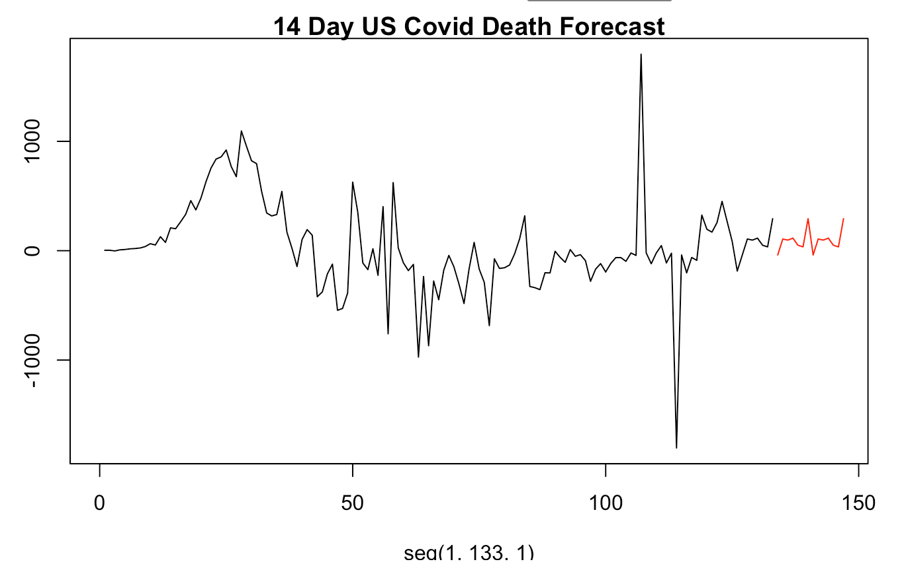
US Forecasts: Model 1
Model 1: Focusing on Deaths
BIC picks an ARMA (1,1) model with a s = 7
  (1-.9B) X_{t} = (1−.6B) a_{τ}
Absolute Reciprocal: 0.903

Slide 8
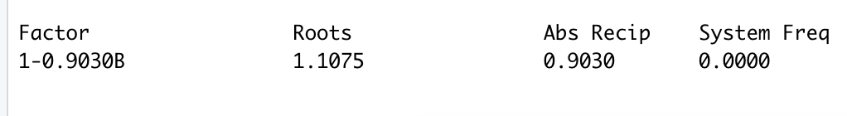
US Forecast: Model 2
Assumed a Stationary Seasonality
AIC Picks an ARUMA (1,0,1) with an S of = 7
Factor Table:
Provides a forecast that accounts for the seasonal week long trend to continue.

Slide 9
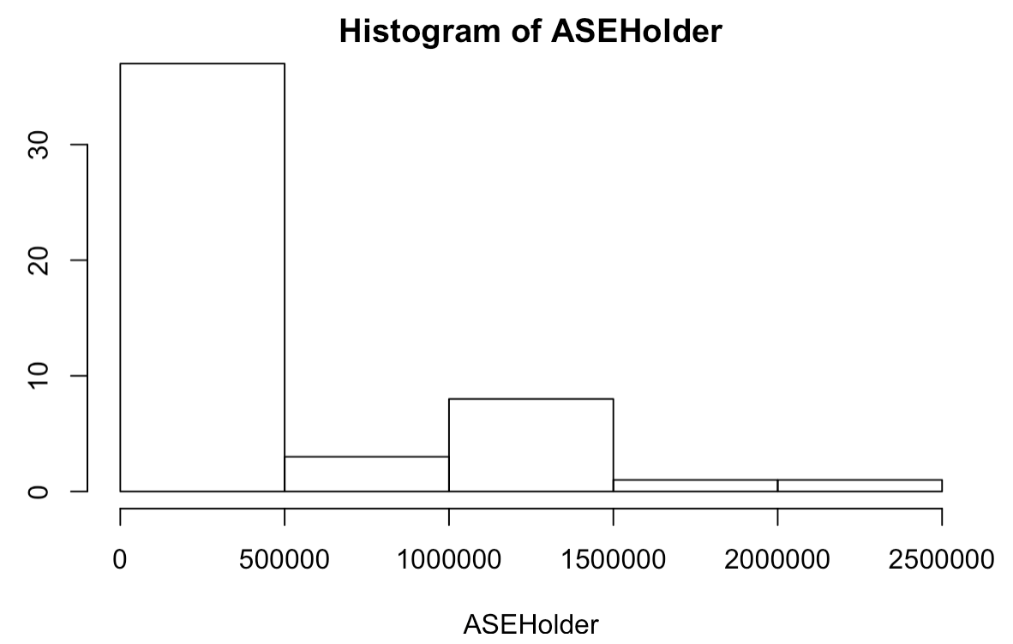
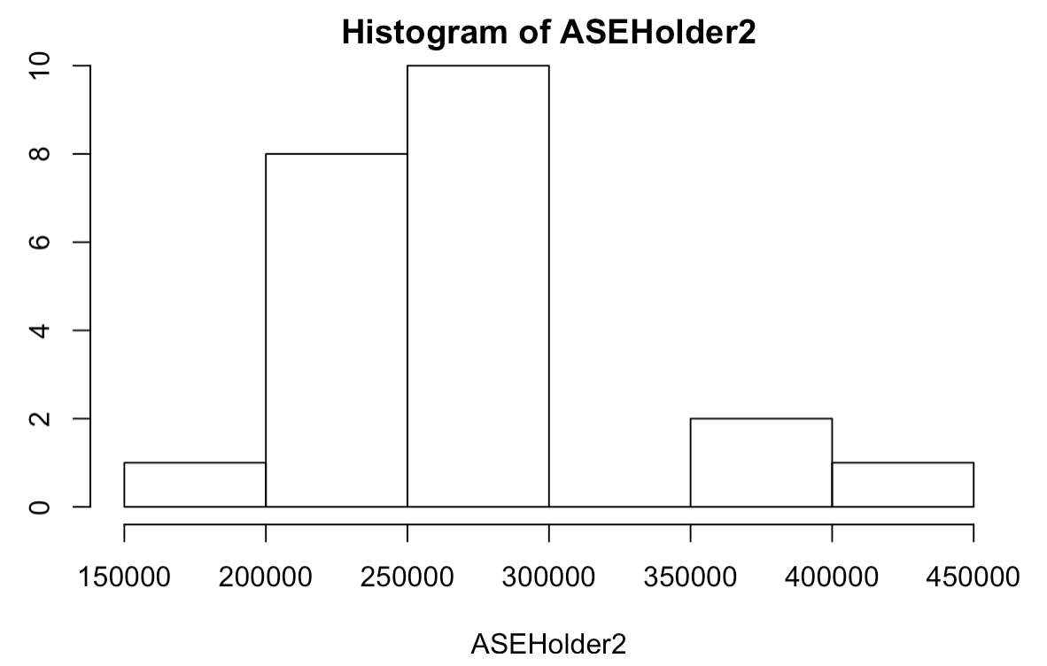
Model 2: Short Term and Long Term Window
14 day Forecast
42 day forecast
Min ASE was 41,453, Max was 2,260,058
Mean was 479,766
Min ASE was 193,428, Max was 435,798
Mean was 267,922

Slide 10
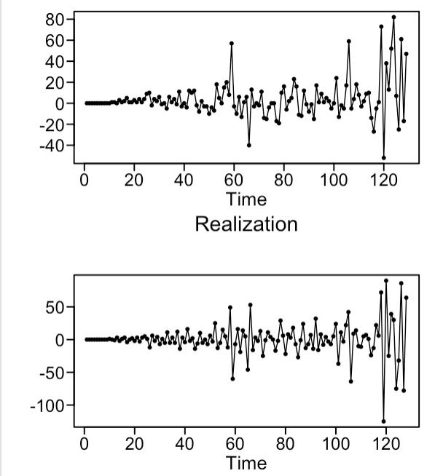
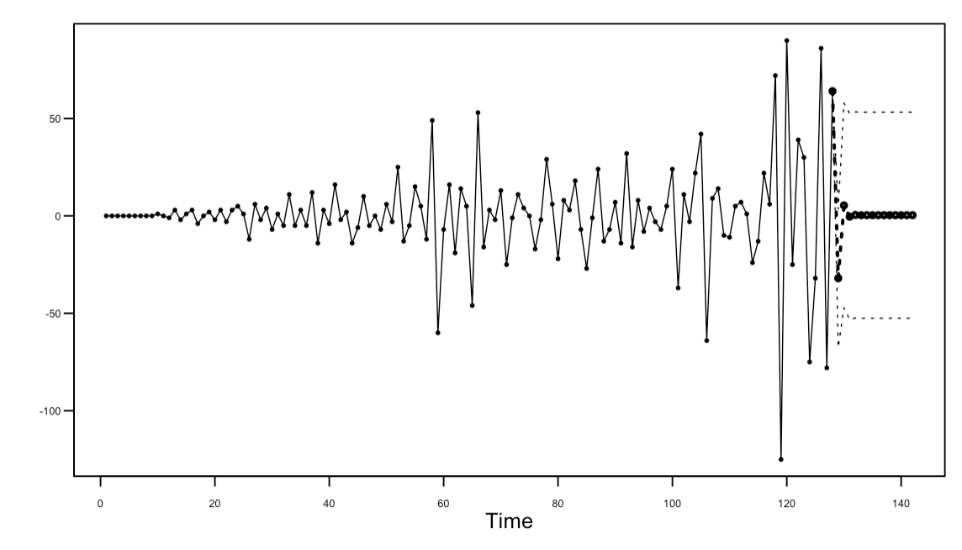
AZ Forecast: Model 1
Account for a lag of 7 like the US Data
Include an ARIMA 1 to reduce effect of spikes
AIC selects an ARIMA (1,1,1) model with S = 7
  (1+.16B)(1-B)(1-B^7) X_{t} = (1−.9B) a_{τ}
∗ Estimate suggests we regress to the the mean

Slide 11
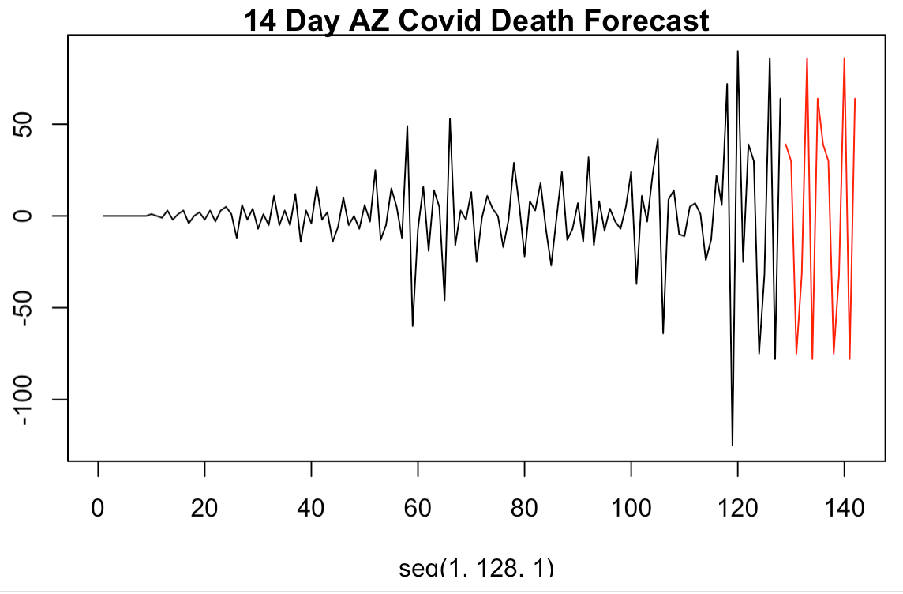
AZ Forecast: Model 2
Assumes stationary seasonality
AIC Selected ARMA (1,1) with S=7
(1+.16B) X_{t} = (1−.9B) a_{τ}
Forecast accounts for continued trend

Slide 12
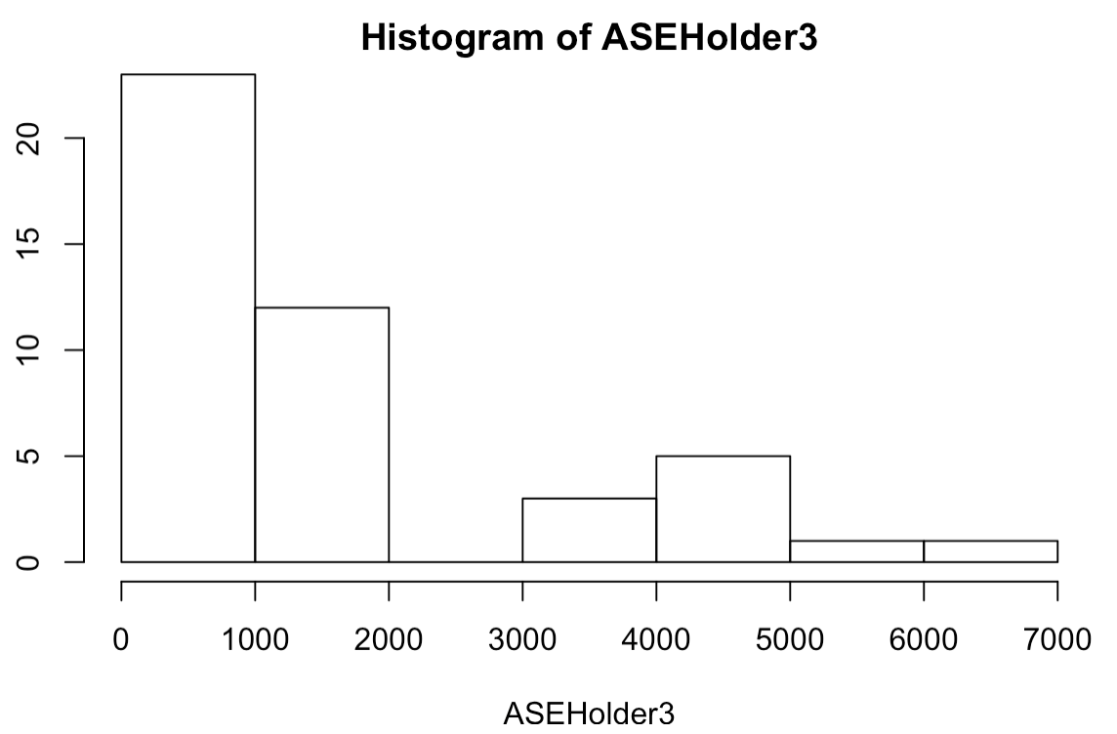
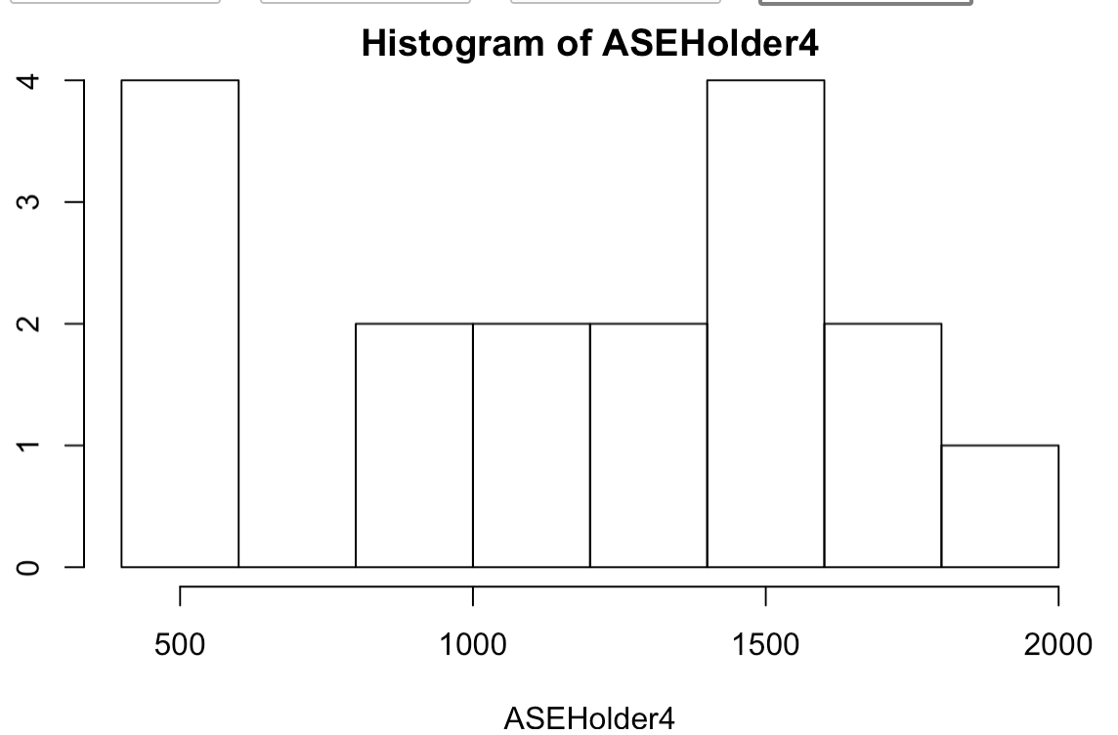
AZ Forecast: Short and Long Term ASE
14 day ASE
42-Day ASE
Min ASE is 383.5, Max is 6026.6
Mean is 1668.6
Min ASE is 467.6, Max is 1992.0
Mean is 1171.1

Slide 13
Next Steps
Explore Multivariate forecasts including hospitalizations, positive/negative cases, as well as positive percentage rate.
Explore VAR and Neural Nets to better forecast performance over time

Slide 14
Appendix

Slide 15
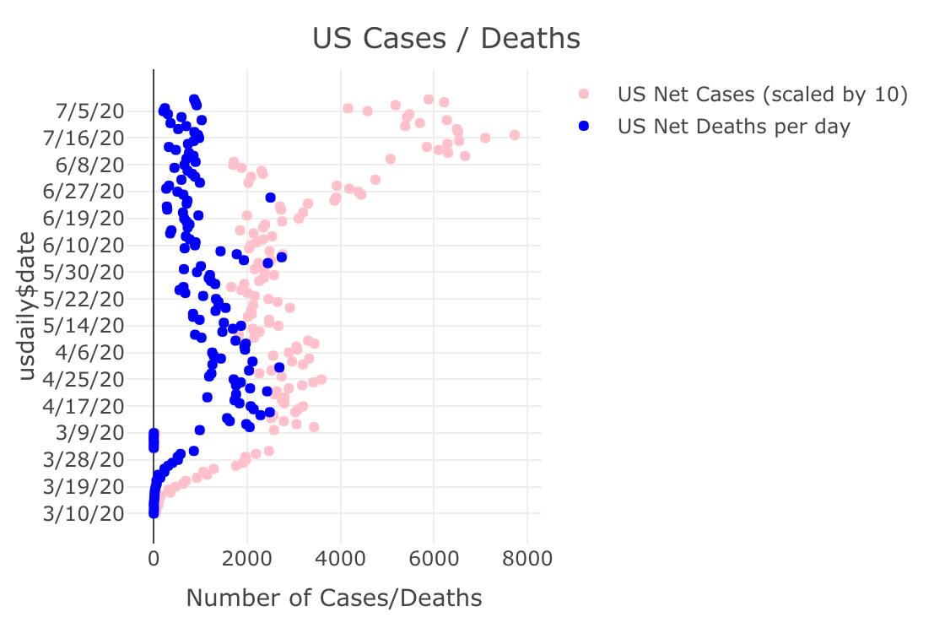
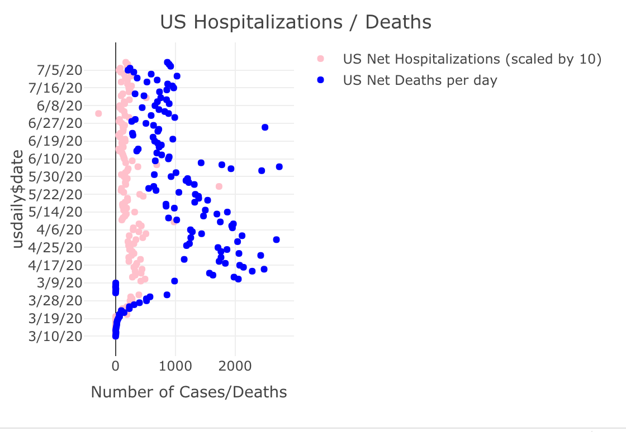
EDA
Reviewing both a comparison of hospitalizations and cases over time with deaths, we have not seen a that deaths and hospitalizations have not spiked with the influx of new cases since June.

Slide 16
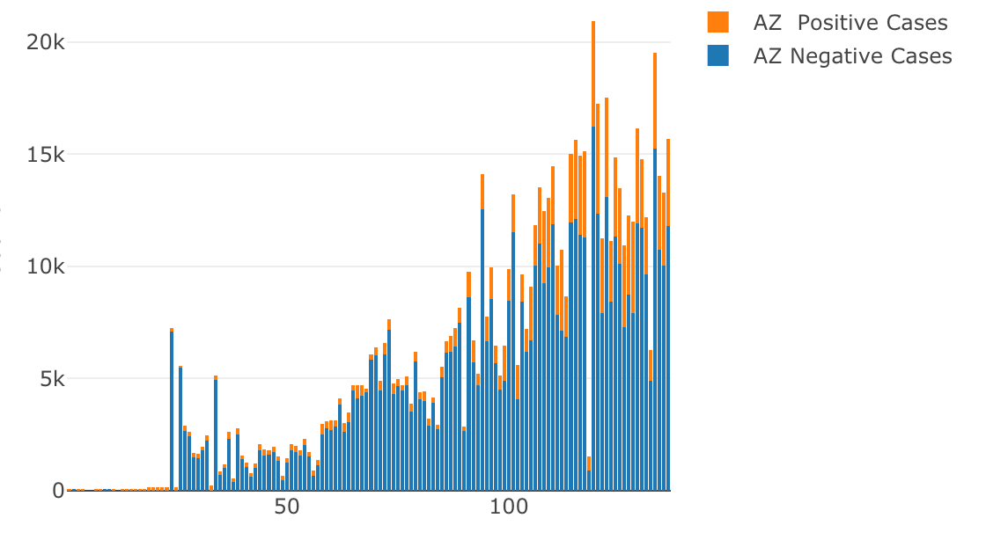
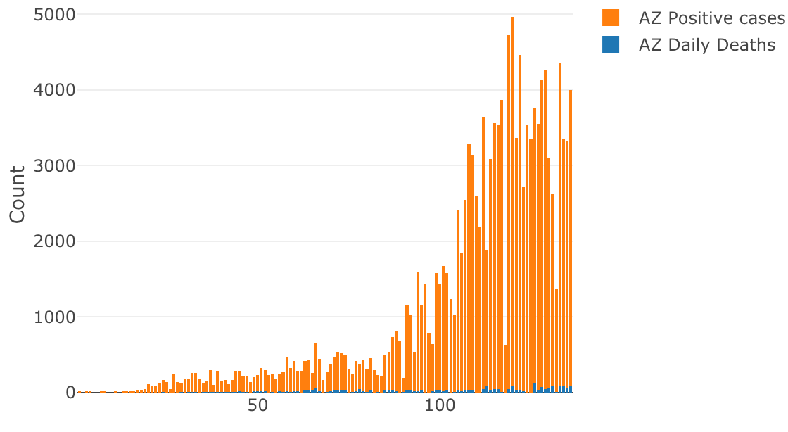
EDA
Looking specifically at the Arizona data, we have a couple of interesting findings.
The amount of testing that took place grew exponentially.
The percentage of positive tests also seemed to increase over time, which suggests that around mid-may is when the virus started to spread in AZ.
While the positive cases have been high, the percent of deaths significantly decreased (meaning the number of deaths remained low.)

Slide 17
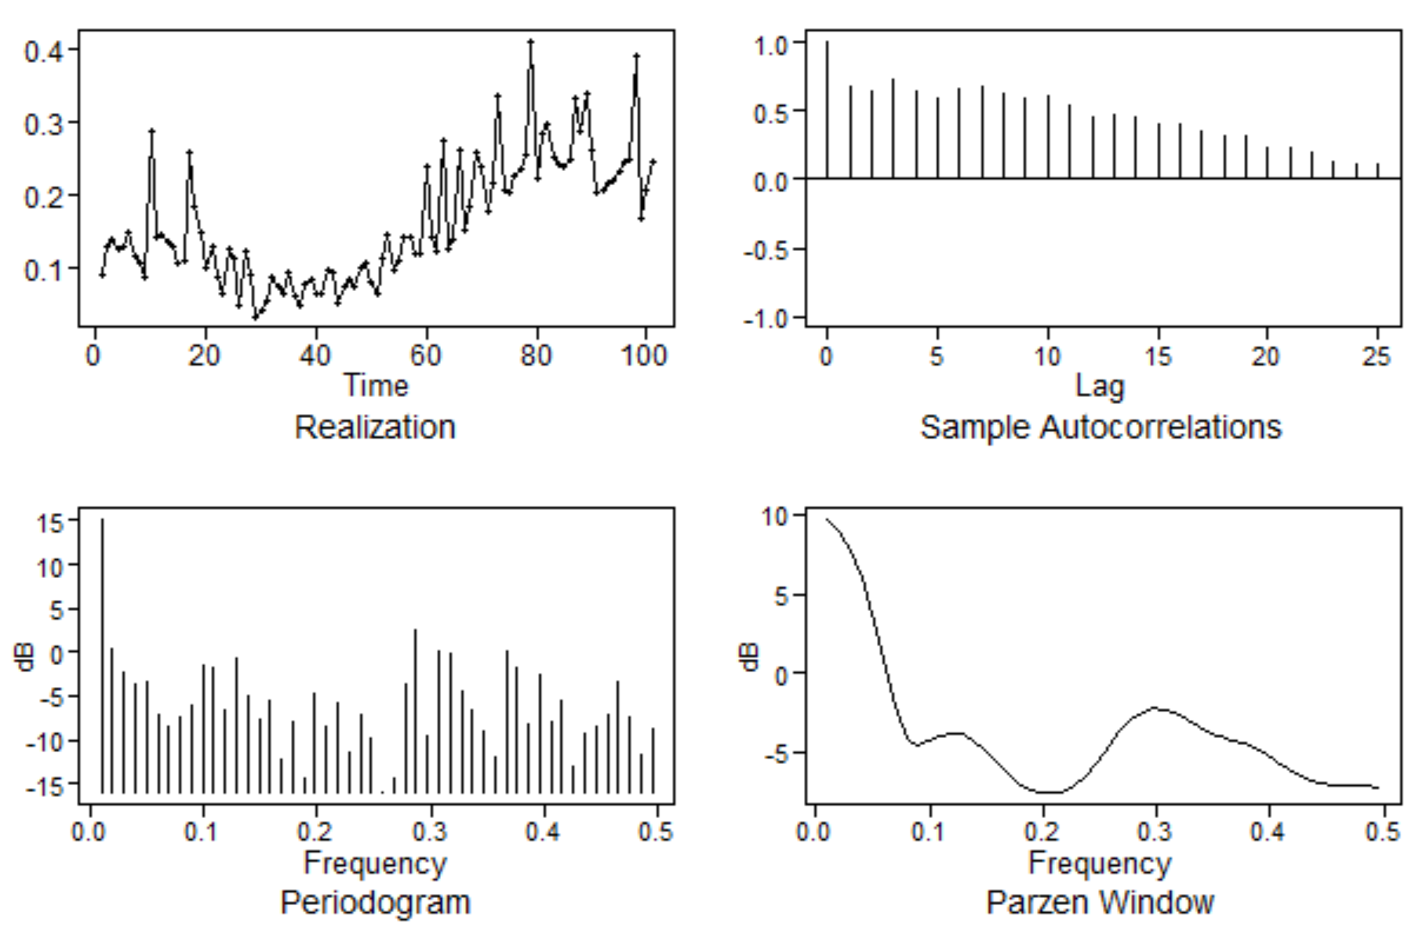
DATA SOURCE AND ATTRIBUTES USED TO CALCULATE POSITIVE PERCENTAGE
SOURCE: HTTPS://covidtracking.com/data/download
CSV Files Downloaded: USDaily and AZDaily
[1] "date" "state"
[3] "positive" "negative"
[5] "pending" "hospitalizedCurrently"
[7] "hospitalizedCumulative" "inIcuCurrently"
[9] "inIcuCumulative" "onVentilatorCurrently"
[11] "onVentilatorCumulative" "recovered"
[13] "dataQualityGrade" "lastUpdateEt"
[15] "dateModified" "checkTimeEt"
[17] "death" "hospitalized"
[19] "dateChecked" "totalTestsViral"
[21] "positiveTestsViral" "negativeTestsViral"
[23] "positiveCasesViral" "deathConfirmed"
[25] "deathProbable" "fips"
[27] "positiveIncrease" "negativeIncrease"
[29] "total" "totalTestResults"
[31] "totalTestResultsIncrease" "posNeg"
[33] "deathIncrease" "hospitalizedIncrease"
[35] "hash" "commercialScore"
[37] "negativeRegularScore" "negativeScore"
[39] "positiveScore" "score"
[41] "grade"
posper = (az2$positiveIncrease[40:140] /
az2$totalTestResultsIncrease[40:140])

Slide 18
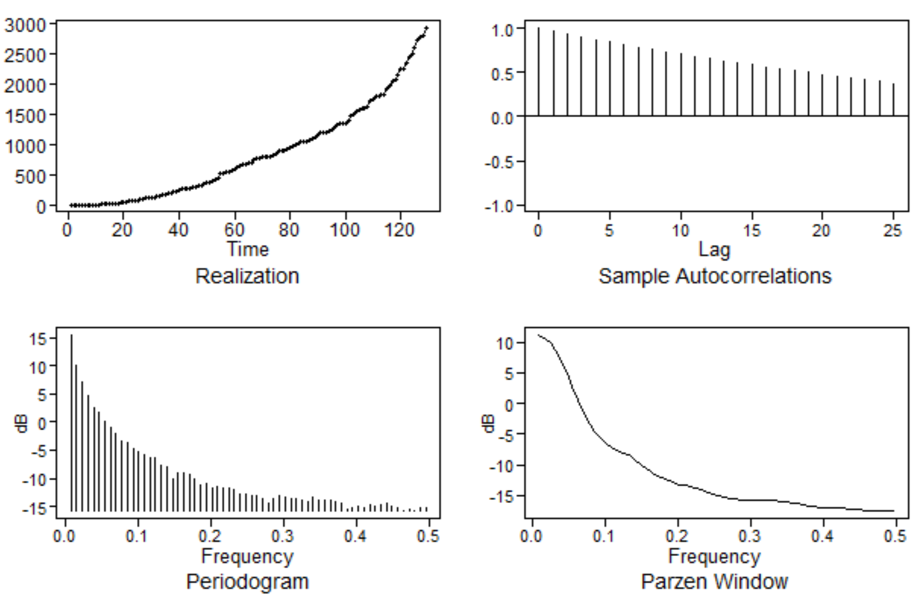
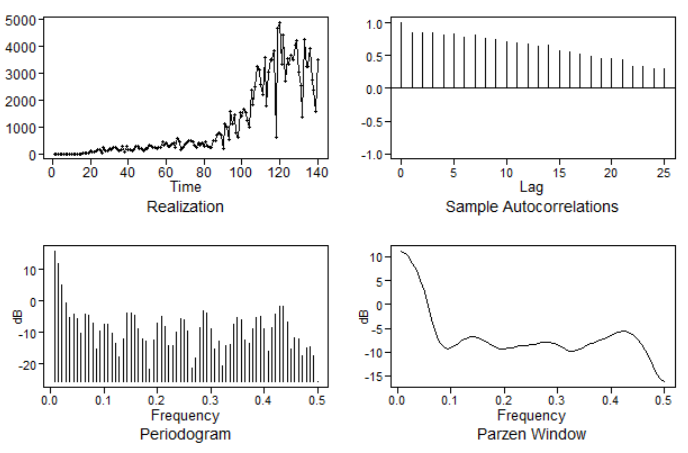
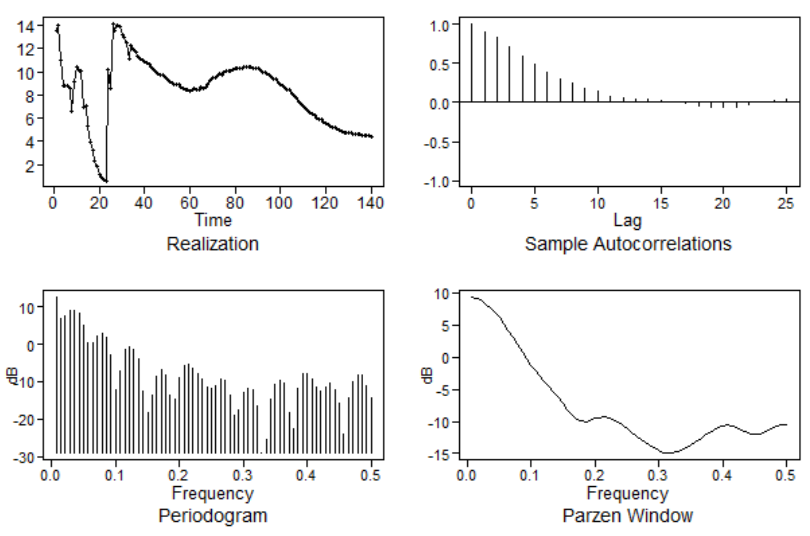
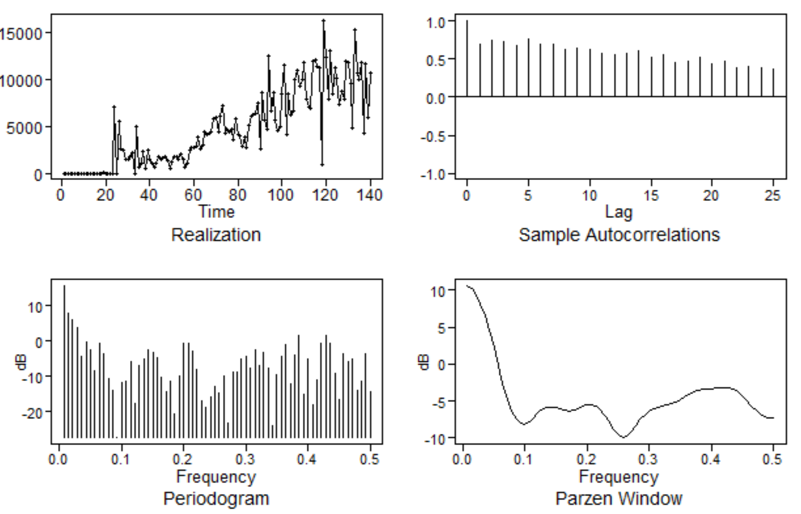
Eda plots
Increase in Positive Cases over Time
Cumulative Death
CUMULATIVE NEGATIVE/POSITIVE CASES
Increase in Negative Cases over Time
Once the data stabilizes there seems to be a trend, that as the ratio of neg/pos decreases, that positives are increasing relative to negatives.

Slide 19
Using the Positive Percentage Calculation, 4 Models were Fit
Positive Percentage
posper = (az2$positiveIncrease[40:140] /
az2$totalTestResultsIncrease[40:140])

Slide 20
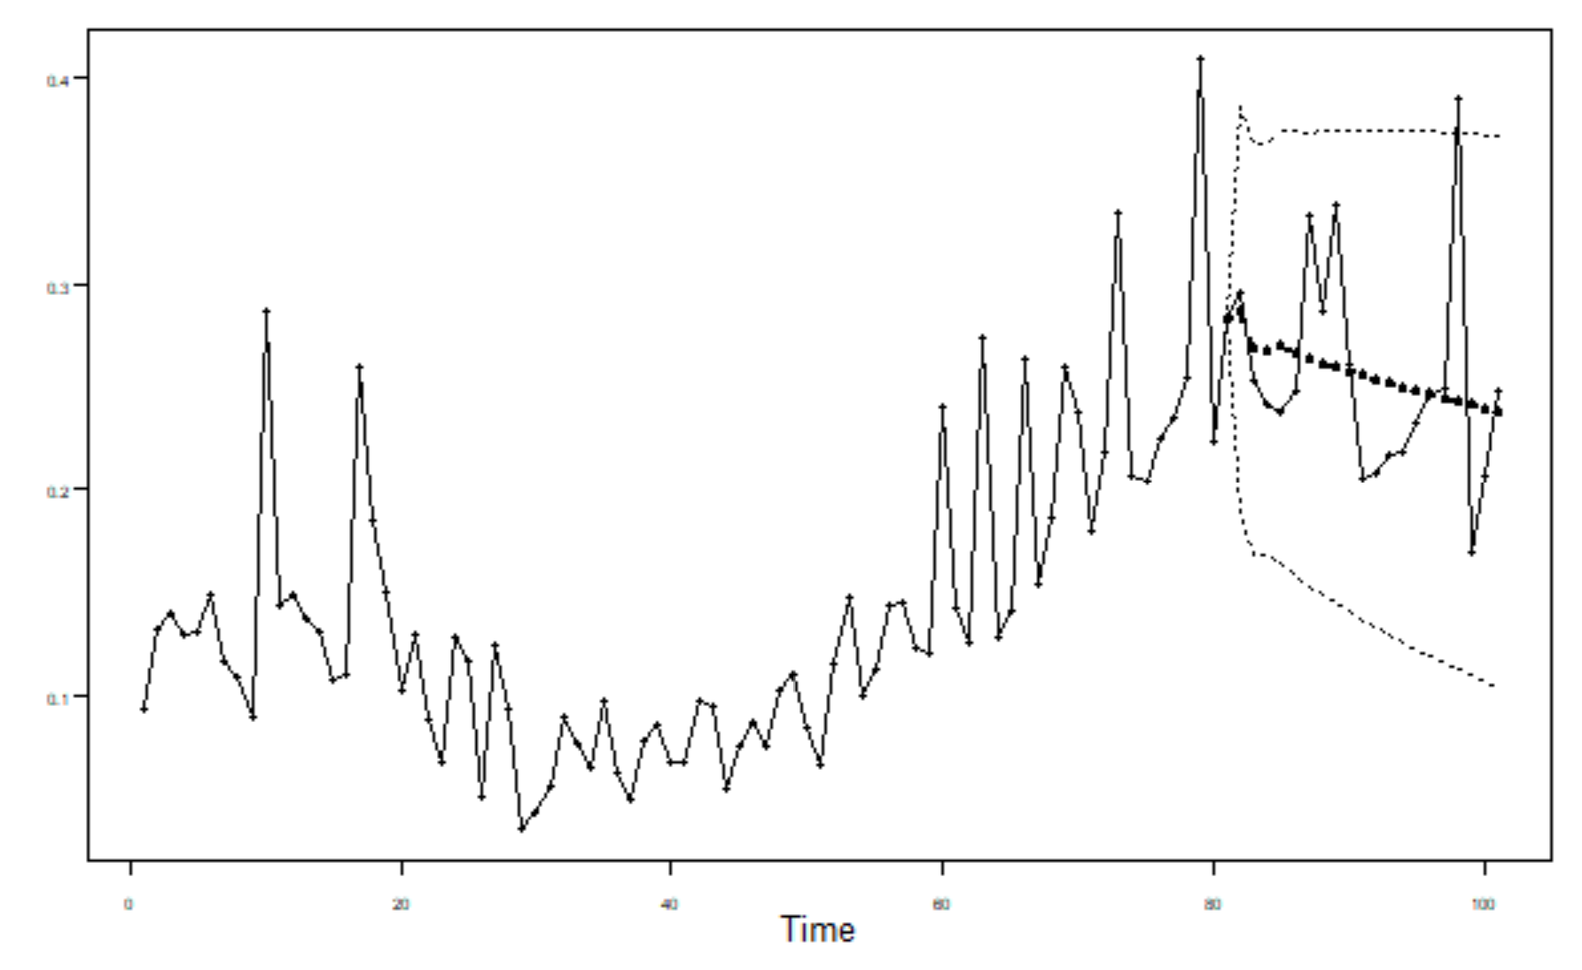
The ARMA(3,1) has the lowest ASE (ASE for Model 4 not yet calculated)
[1] "So, In Summary, the ASE Values Are:"
> print(paste('Arma(1,1):', ASE11))
[1] "Arma(1,1): 0.0026056877866528"
> print(paste('Arma(3,1):', ASE31))
[1] "Arma(3,1): 0.00249414972410202"
> print(paste('Arima(6,1,0):', ASENS))
[1] "Arima(6,1,0): 0.0291083749638043"
> print(paste('Aruma(3,0,1)s=7:', ASEs7))
Error in paste("Aruma(3,0,1)s=7:", ASEs7) : object 'ASEs7' not found
Model 1: ARMA(3,1)
  Phi = 0.77921206 -0.04876885 0.23976441
  Theta = 0.5975179
  AVAR = 0.0024
Model 2: ARMA(1,1)
  Phi = 0.9814926
  Theta = 0.7445438
  AVAR = 0.0026
Model 3: ARIMA(6,1,0)
  Phi = -0.8083 -0.7075 -0.4040 -0.4033 -0.4287 -0.2714
  AVAR = 0.00226
Model 4: ARUMA(3,0,1)s=7
  Phi = -0.14734572 0.07743428 0.30573178
  Theta = -0.1703865
  AVAR = 0.0034
Mean(posper) = 0.162

